Slide 1


Intro to Git and GitHub
New England Microsoft Developers User Group
Andrew Babiec
2019-05-02

Slide 2
What is Git?
Distributed Version Control System (VCS)
Version Control System: track changes to source code: who, what, why, when

Slide 3



Centralized vs. Distributed VCS
Centralized repository
Distributed repository
CVS, Perforce, Subversion, TFVC, ClearCase, etc.

Slide 4
Other benefits of Git
Fast and lightweight branching and merging
Unique branching model & approach
Speed/Performance
Local commits
Very Popular and well-supported
Supports a non-linear development model
Free and open-source

Slide 5
What is Github?
Online Service/Collaboration Platform
Core function is an online git service & collection of repos
Adds: issues, pull requests, code review, orgs & teams, integrations, pages, etc.

Slide 6


Are we back to a Centralized VCS if we use Github?
Not Really.
Each local repo is still a self-contained, disconnected full copy GitHub is a shared remote repository, used as a common source of truth

Slide 7
Starting Point - Git Repo/Project
Git Repository (repo/project)
Collection of files and folders, along with full history across all branches
Characteristics
Local & offline/disconnected
Includes everything - Entire timeline/history of changes, all branches
Stored in the local .git folder of each repo
Commits (changes) are snapshots, not deltas
Changes are always additions
History - snapshots in time called commits

Slide 8
Creating or Getting Repo/Projects
Create Project
Git init
Clone an existing repository
Git clone

Slide 9
Git Clone Demo

Slide 10
Git repo/project data
Git stores 3 copies of a project on your workstation.
One copy is your own repository with your own commit history.
The second copy is your working copy where you are editing and building.
State can be Working or Staged
The third copy is your local "cached" copy of a remote repository.
Git saves space by storing file contents as unique, compressed blobs identified by a hash

Slide 11
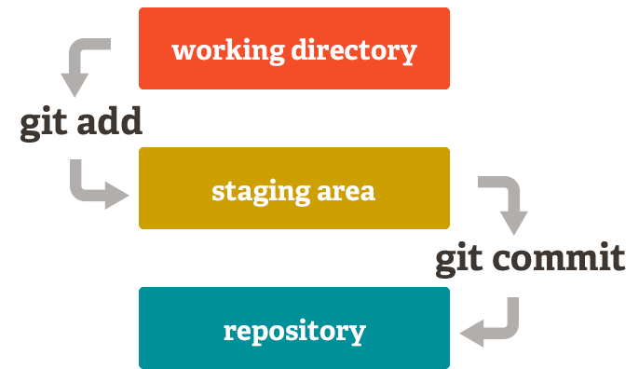
Git Two Stage Commit
Working/modified/workspace > Staging (index) > Committed/history/repo

Slide 12
Git File States
Files exist in 1 of 4 states
Untracked, Modified, Staged or Committed
An untracked file is one that is not currently part of the version controlled directory
Git commands for adding, moving, renaming and removing/deleting files
git add
git mv (move and rename)
git rm (remove)

Slide 13
local repo

Slide 14
local repo

Slide 16
Managing changes
Local changes
Git commit
Git status
Git log
Git diff
Git reset – undo a commit/merge/pull
Sharing and Updating with remote repositories
Git fetch
Git pull
Git push

Slide 17
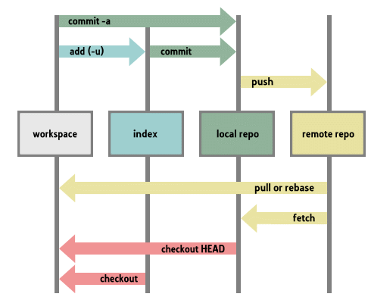

Slide 18
local repo

Slide 19
Git commit Demo

Slide 20
Git Remotes
Remotes - remote repository
Origin - default name for remote cloned from
Merge Conflicts: local & remote
Commands
Fetch - get changes from remote, updates remote-tracking branch
Pull - combination of git fetch & git merge, updates current local branch
Push - push changes to remote

Slide 21
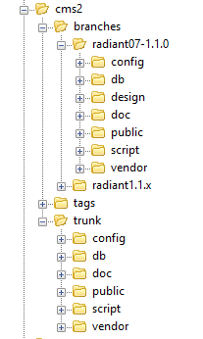
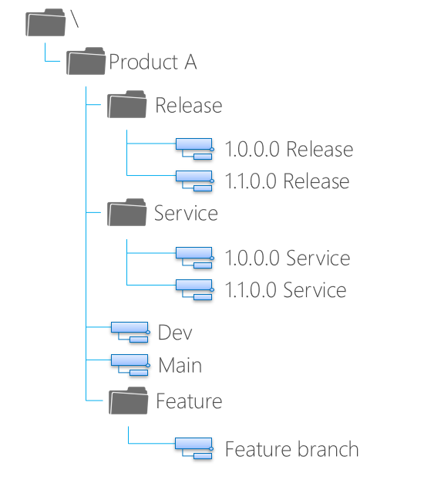
Traditional Source Control Branching

Slide 22
Git Branches
Exist at the repository level
A branch applies to the entire repository
Default branch is ‘Master’ - consider this the canonical version of your source code
Add additional branches to organize your changes
Add a new feature
Try something experimental
Anything
Checkout – switch branch

Slide 23
Git Branches
Branches are not represented in source control
Exist at a level above the source code in the repo
Unlike most centralized version control tools where branches exist inside the folder structure
Remote branches represented as origin\{branch-name}
Exceptionally lightweight
Implemented as a pointer to a commit in the graph
Exist only in the local repository until they’re explicitly shared
Encourages feature branching

Slide 24
Git Branches – Merging Changes
Git merge
Incorporates changes from the named branch into the current branch
Git rebase
Similar to merge
Reorder commits, edit them, squash multiple commits into one, etc.
Warning: Never use rebase on shared branches (like master)

Slide 25
Git Branch Demo

Slide 26
Git terminology to know
head - symbolic reference to the branch you’re on. By default, there is a "head" in every repository called master.
HEAD - currently active head/branch
Tags - pointer to a commit (like a label)
Stash – stash or shelve changes to the working copy
Cherry-pick - pick up a specific commit

Slide 27
Git Commands
init, clone
add, mv, rm, reset, clean
checkout, commit
status, log, show, grep, reflog
branch, merge, diff, rebase, tag
fetch, pull, push
config, remote

Slide 28
GitHub

Slide 29
Github
Enhancements on top of Git
Fork - copy another public repository
Pull Request (PR) – merge changes using a code review & approval step
Github Flow
Create Branch, Add Commits, Open PR, Discuss & Review, Merge & Deploy
Note: Now includes unlimited free private repositories (up to 3 collaborators)

Slide 30
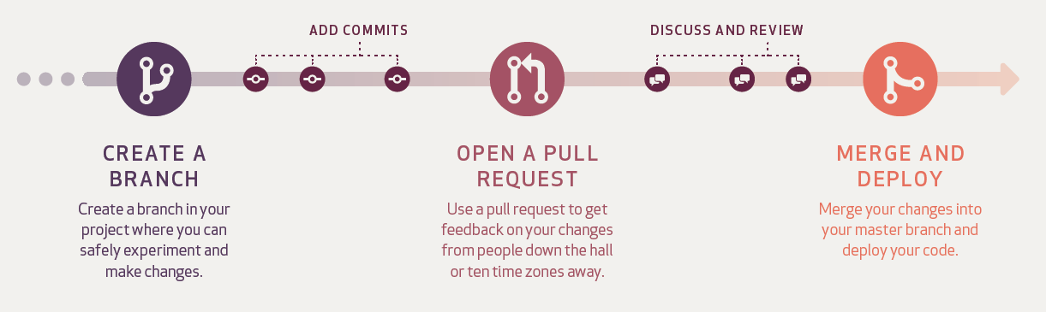
GitHub Flow

Slide 31
Github Pull Request Demo

Slide 32
Git and Github Resources
https://git-scm.com/
https://guides.github.com/
https://lab.github.com/
https://learngitbranching.js.org/
http://www.ndpsoftware.com/git-cheatsheet.html

